Slide 1
UCS1405 – SOFTWARE ENGINEERING
Life Cycle Models
Dr.K.Madheswari
Associate Professor
CSE

Slide 2
Learning Objective
To give an introduction to process models.
To learn the different types of process models.
To analyze different models and in turn comparative study of the models
perform

Slide 3
Overview
Prescriptive Models
Waterfall Model
Incremental Model
RAD
Evolutionary models
Specialized process models

Slide 4
Prescriptive Models
Prescriptive process models advocate an orderly approach to software engineering
That leads to a few questions …
If prescriptive process models strive for structure and order, are they inappropriate for a software world that thrives on change?
Yet, if we reject traditional process models (and the order they imply) and replace them with something less structured, do we make it impossible to achieve coordination and coherence in software work?
A prescriptive process model populates a process framework with explicit task sets for software engineering actions.

Slide 5
The Waterfall Model
Communicat ion
project init iat ion
requirement gat hering
Planning
estimating sch edu ling tracking
Modeling
analysis design
Const ruct io
code t est
n
Deployment
delivery support
f eedback

Slide 6
The Waterfall Model
Also known as Classical life cycle or linear sequential model.
The oldest and the most widely used software engineering paradigm.
A systematic, sequential approach to software development that begins at the system level and progresses through planning, modeling, construction and deployment, culminating in on-going support of the completed software.

Slide 7
Problems in the Waterfall Model
Real projects rarely follow the sequential flow that the model proposes. Although the linear model can accommodate iteration, it does so indirectly. As a result, changes can cause confusion as the project team proceeds.
It is often difficult for the customer to state all requirements explicitly.
The customer must have patience. A working version of the program(s) will not be available until late in the project time-span. A major blunder, if undetected until the working program is reviewed, can be disastrous.
leads to “blocking states” - some project team members must wait for other members of the team to complete dependent tasks.
The time spent waiting can exceed the time spent on productive
work!

Slide 8
Where to use the waterfall model?
In situations where requirements are fixed and work is to proceed to completion in a linear manner.
Large scale projects where requirements are well defined

Slide 9
Key points
It provides a template into which methods for analysis, design, coding, testing, and support can be placed.
The classic life cycle remains a widely used procedural model
for software engineering.
While it does have weaknesses, it is significantly better than a haphazard approach to software development.

Slide 10

The Incremental Model
increment # n
C o m m u n i c a i o n
P l a n n i n g
M o d e l i n g
a n a l y s i s
d e s i g n
C o n s t r u c t i o n
c o d e t e s t
D e p l o y m e n d e l i v e r y
f e e d b a c k
deliv ery of
nt h increment
increment # 2
C o m m u n i c a i o n
P l a n n i n g
M o d e l i n g
a n a l y s i s
d e s i g n
C o n s t r u c t i o n
c o d e t e s t
D e p l o y m e n t d e l i v e r y
f e e d b a c k
deliv ery of 2nd increment
increment # 1
C o m m u n i c a t i o n
P l a n n i n g
M o d e l i n g
a n a l y s i s d e s i g n
C o n s t r u c t i o n
c o d e t e s t
D e p l o y m e n t d e l i v e r y
f e e d b a c k
deliv ery of 1st increment
project calendar t ime

Slide 11
The Incremental Model
It combines the elements of waterfall model applied in an iterative fashion.
Each linear sequence produces deliverable “increments” of the software.
The first increment is often a core product.

Slide 12
Where to use the Incremental model?
In situations when staffing is unavailable for a complete implementation by the business deadline that has been established for the project.

Slide 13
The RAD Model
Team # n
M o d e lin g
business m odeling data m odeling process m odeling
Team # 2
Mo d eling
business m odeling
Co n st ru ct io n
com ponent reuse
autom at ic code generation
testing
Communicat ion
dat a m odeling
process m odeling
Planning
De ployme nt int egrat ion deliv ery
feedback
Team # 1
Co nst r uct io n
com ponent reuse
aut om at ic code generat ion
t est ing
Mode ling
business modeling dat a modeling process modeling
Const ruct ion component reuse aut omat ic code
generat ion t est ing
6 0 - 9 0 days

Slide 14
The RAD Model
Rapid application development (RAD) is an incremental software development process model that emphasizes a short development cycle.
The RAD model is a “high-speed” adaptation of the linear sequential model in which rapid development is achieved by using component-based construction.
If requirements are well understood and project scope is constrained, the RAD process enables a development team to create a “fully functional system” within very short time periods (e.g., 60 to 90 days).
Used primarily for information systems applications.

Slide 15
The RAD Model (cont..)
Business modeling:
The information flow among business functions is modeled in a
way that answers the following questions:
What information drives the business process?
What information is generated?
Who generates it?
Where does the information go?
Who processes it?
Data modeling:
The information flow defined as part of the business modeling phase is refined into a set of data objects that are needed to support the business.
The characteristics (called attributes) of each object are identified and the relationships between these objects defined.

Slide 16
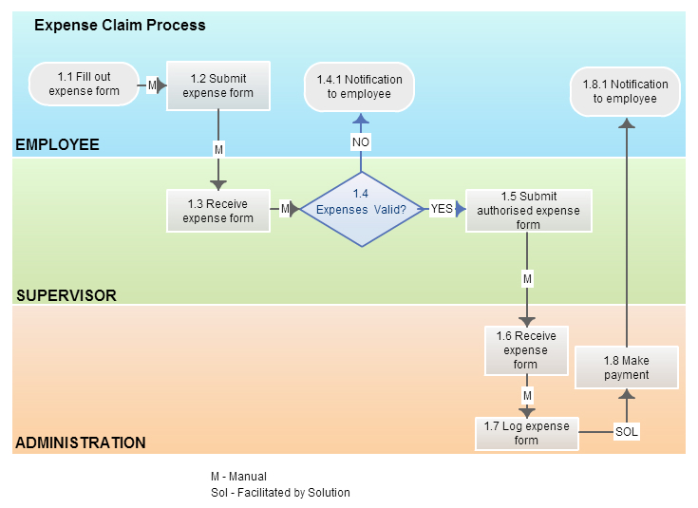
Business modeling

Slide 17
Process modeling:
The data objects defined in the data modeling phase are transformed to achieve the information flow necessary to implement a business function.
Processing descriptions are created for adding, modifying, deleting, or
retrieving a data object.
Construction:
RAD assumes the use of fourth generation techniques
Rather than creating software using conventional third generation programming languages the RAD process works to reuse existing program components (when possible) or create reusable components (when necessary).
In all cases, automated tools are used to facilitate construction of the
software.
Testing and turnover:
Since the RAD process emphasizes reuse, many of the program components have already been tested.
This reduces overall testing time.

Slide 18
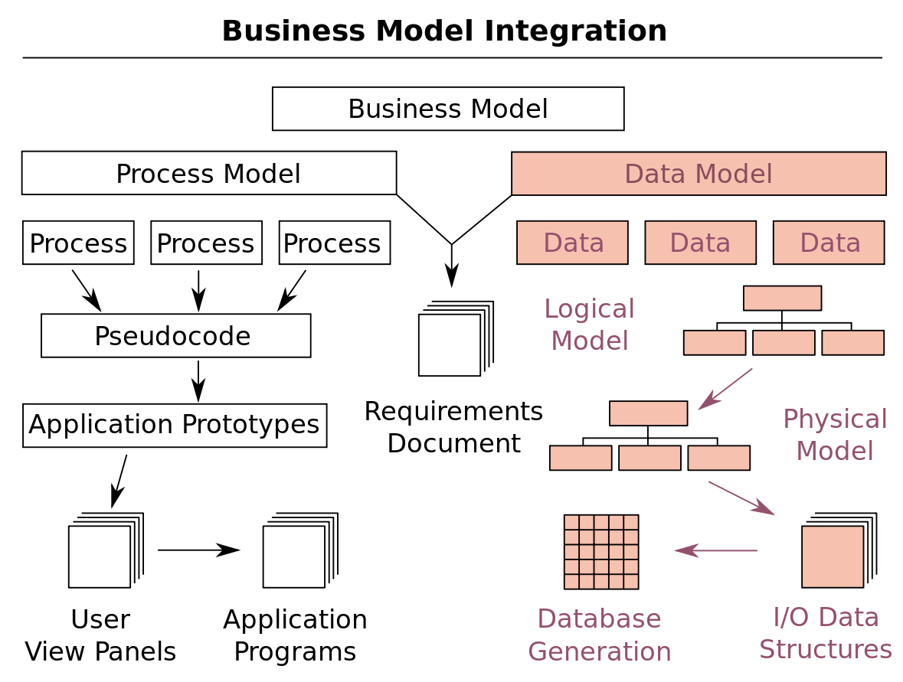

Slide 19
For large but scalable projects, RAD requires sufficient human resources to create the right number of RAD teams.
RAD requires developers and customers who are committed to the rapid-fire activities necessary to get a system complete in a much abbreviated time frame. If commitment is lacking from either constituency, RAD projects will fail.
Not all types of applications are appropriate for RAD. If a system cannot be properly modularized, building the components necessary for RAD will be problematic.
If high performance is an issue and performance is to be achieved through tuning the interfaces to system components, the RAD approach may not work.
RAD is not appropriate when technical risks are high. This occurs when a new application makes heavy use of new technology or when the new software requires a high degree of interoperability with existing computer programs.

Slide 20
Where to use the RAD model?
Business product with unclear requirements

Slide 21
Need for prototyping
The customer defines a set of general objectives for software but does not identify detailed input, processing, or output requirements.
In other cases, the developer may be unsure of
The efficiency of an algorithm,
The adaptability of an operating system, or
The form that human/machine interaction should take.
A prototyping paradigm may offer the best approach.
It serves as a mechanism for identifying software requirements.
It serves as a first system.

Slide 22
Evolutionary Models: Prototyping
Quick plan
Q u ick p lan
n
communication
Com m unicat io
Modeling Quick designg n
Mo d e lin g
Qu ick d e si
Deployment
De live r y
& Fe e dback
Deployment delivery & feedback
Const r uct ion
of
pr ot ot ype
Construction
of prototype

Slide 23
The prototyping paradigm begins with
Requirements gathering:
Developer and customer meet and define the overall objectives for the Software,
Identify whatever requirements are known,
outline areas where further definition is mandatory.
Quick design:.
The quick design focuses on a representation of those aspects of the software that will be visible to the customer/user (e.g., input approaches and output formats).
The quick design leads to the construction of a prototype. The prototype is evaluated by the customer/user and used to refine requirements for the software to be developed.
Iteration occurs as the prototype is tuned to satisfy the needs of the customer, while at the same time enabling the developer to better understand what needs to be done.

Slide 24
Problems in prototyping
The customers sees what appears to be a working version of the software, unaware that the prototype is held together “ with chewing gum and baling wire” .
The developer often makes implementation compromises in order to get a prototype working quickly.

Slide 25
Where to use the prototyping?
Business product with unclear requirements

Slide 26


Evolutionary Models: The Spiral
planning estimation scheduling
risk analysis
communication
modeling analysis design
start
deployment delivery feedback
construction
code
test

Slide 27
Originally proposed by Boehm, couples iterative nature of prototyping and the systematic aspects of waterfall model
Rapid development of versions.
Software is developed in series of incremental releases.
Each iteration produces a more complete product
Better management through risk analysis.
During early iterations, the incremental release might be a paper model or prototype.
During later iterations, increasingly more complete versions of the engineered system are produced.
Anchor point milestones- a combination of work products and conditions that are attained along the path of the spiral.
The first circuit around the spiral might result in the development of a product specification.
Subsequent passes around the spiral might be used to develop a prototype and then progressively more sophisticated versions of the software.

Slide 28
May be difficult to convince customers that evolution is controllable
Demands risk assessment expertise : major risk will cause problems if not identified
Relatively new and not widely used, so cannot determine performance

Slide 29
Where to use the Spiral model?
R&D/large scale projects where privacy/security issues are
involved

Slide 30
Evolutionary Models: Concurrent
none
Modeling act ivit y
Under development
represents the state
of a software engineering activity or task
A wait ing changes
Under review
Under revision
Baselined
Done

Slide 31
The concurrent process model can be represented schematically as a series of framework activities, software engineering actions and tasks, and their associated states.
For example, the modeling activity defined for the spiral model is accomplished by invoking the following tasks:
prototyping and/or analysis modeling,
requirements specification, and design
For example,
early in a project the customer communication activity has completed its first iteration and exists in the awaiting changes state.
The modeling activity (which existed in the none state while initial customer communication was completed) now makes a transition into the under development state.
If, however, the customer indicates that changes in requirements must be made, the modeling activity moves from the under development state into the awaiting changes state.

Slide 32
Where to use the Concurrent process model?

Slide 33
Specialized Process Models
Component based development—the process to apply when reuse is a development objective
Formal methods—emphasizes the mathematical specification of requirements
AOSD—provides a process and methodological approach for defining, specifying, designing, and constructing aspects
Unified Process—a “use-case driven, architecture-centric, iterative and incremental” software process closely aligned with the Unified Modeling Language (UML)

Slide 34
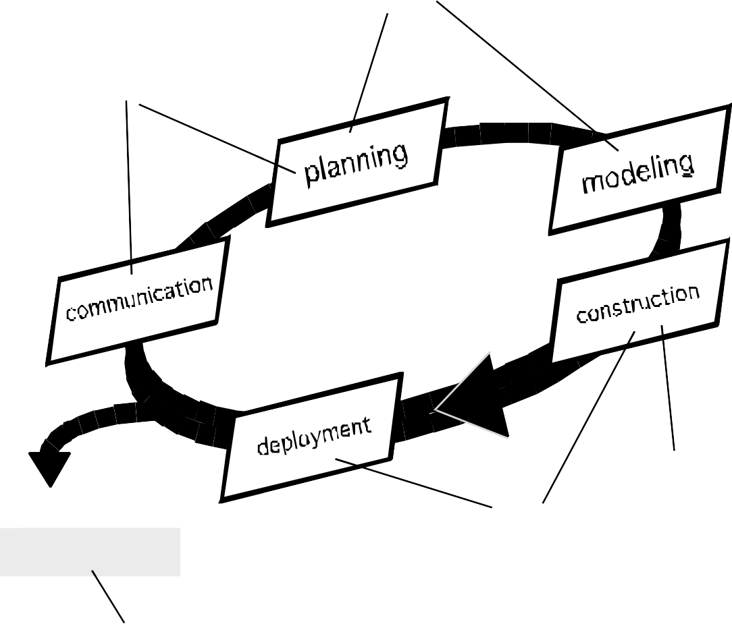
The Unified Process (UP)
Elab o r at io n
inception
Incep t io n
co nst r uct io n
t r ansit io n
Release
soft ware increment
p r o d uct io n

Slide 35
UP -Work Products
Inception phase
Vision document
Init ial use-case model Init ial project glossary Init ial business case Init ial risk assessment . Project plan,
phases and it erat ions.
Business model, if necessary.
One or more prot ot ypes
Elaboration phase
Use-case model
Supplement ary requirement s including non-funct ional
Analysis model
Soft ware archit ect ure
Descript ion.
Execut able archit ect ural prot ot ype.
Preliminary design model Revised risk list
Project plan including
it erat ion plan adapt ed workflows milest ones
t echnical work product s Preliminary user manual
Const ruct ion phase
Design model
Soft ware component s Int egrat ed soft ware
increment
Test plan and procedure Test cases
Support document at ion
user manuals
inst allat ion manuals descript ion of current
increment
Transition phase
Delivered soft ware increment Bet a t est report s
General user feedback

Slide 36
Summary
Prescriptive Models
Waterfall Model
Incremental Model
RAD
Evolutionary models
Specialized process models

Slide 37
Check your understanding
When do we use “formal methods’?
What process model should be used when requirements are fixed?

Slide 38
Reference
Roger S Pressman, “Software Engineering – A Practitioner ’s Approach”, McGraw-Hill International Edition, Seventh Edition, 2010.

Slide 39
Thank you

